Slide 1
CAMPUS SAFETY DEPARTMENT ORIENTATION
Updated April 2022

Slide 2
Authority
Campus Safety Officers:
  Do not possess police powers as outlined in Section 830 of the California Penal Code.
  Have the authority to issue parking citations on the Cal Lutheran Campus and may make arrests as a private person pursuant to Section 837 of the California Penal Code.
  Have the authority to ask people for identification and to determine whether they have lawful business on University property.
  Maintain a working relationship with the Thousand Oaks Police and Ventura County Sheriff ’s Department.

Slide 3
Vision Statement
To provide the Cal Lutheran student, faculty, staff, administration, and visitors a safe and secure learning and working environment by focusing on customer service, best practices, service and justice, and professional development.

Slide 4
ABOUT THE OFFICE

Slide 5
Responsibilities
Campus Safety is responsible for:
Campus Safety Office Operations
Campus Security and Safety Issues
Disaster Preparedness
Fire Life Safety
Environmental Safety and Regulatory Compliance
OSHA Compliance Oversight

Slide 6
OUR PARTNERS
Business Office
Academic Affairs
Residence Life
University Advancement
Information Technology
Services
Athletics
Facilities Operations
Local Emergency Services
Students

Slide 7
CAMPUS SAFETY STAFF
Located at the corner of Olsen Road & Mt. Clef Boulevard
Staffed by:
  Director of Campus Safety
    David Hilke
  Assistant Director of Campus Safety
    Craig Lightfoot
  Campus Safety Supervisors
    Rey Lainez
    Doug Flores
  Operations Assistant
    Carmen Juarez
  Campus Safety Officers
  Front Desk Student Workers
  Traffic Student Workers

Slide 8
OFFICE INFORMATION
Hours
Academic Year Office Hours:
  Monday through Friday: 8 AM to 5 PM
  Saturday and Sunday: Closed
Semester Break Hours may vary, but usually are:
  Monday through Friday: 8 AM – 5 PM
Office Functions
  Campus Safety Emergency Line: (805) 493-3911
  Campus Safety Business (Non-Emergency) Line: (805) 493-3208
Campus Switchboard: (805) 492-2411
Escorting students and staff
Information, Directions, Maps, and Campus Services
Identification card issuance
Dispatch of Campus Safety Officers
Parking Permits
Lost and Found

Slide 9
SAFETY AND SECURITY FUNCTION
Campus Safety Officers do not possess police authority but work closely with the Thousand Oaks Police Department in performing these functions:
Conduct investigations into criminal activity and egregious violations of university policy involving students, staff or faculty.
C.A.R.E. (Campus Awareness, Referral and Education Team) member
Operate the Emergency Notification System (CLU Alert)
Cleary Act Compliance and Reporting
First Responder to medical emergencies and emergency alarms
Parking and traffic control
Building access control
Special Requests: vehicle lockouts, jump starts, escort service.
Assist Residence Life (room searches, fire drills)
Emergency Preparedness Planning
24 hour patrol of University property and buildings/enforce trespass laws

Slide 10
EMERGENCY NOTIFICATION SYSTEM
Provides for text, email, voice (cell or landline phone) messaging in the event of a campus emergency
All students are required to sign up
  Sign up through Blackboard account
It is only affective as the accuracy of the information provided by the student
Emergency information is also available on the Cal Lutheran website: www.callutheran.edu or by calling 1-888-260-5450

Slide 11
SAFETY TIPS

Slide 12
LOSS PREVENTION
“If it is expensive and left alone, it will grow legs and walk off”
Here are some tips to prevent loss of property:
Mark all electronics and valuables (etching, indelible marker)
Record all serial and model numbers
Install a tracking system on computers (Bookstore has them)
Lock your valuables up
Install a computer cable lock and keep it locked down
Lock your room up, do not depend on others
Report unknown persons and allow no one to tailgate into a Residence Hall
Do not leave valuables visible in a vehicle

Slide 13
MORE TIPS
Report missing items immediately
Photocopy all your personal documents in your purse or wallet and keep the photocopy in a safe place
Report lost ID card immediately
Do not leave you room, even for a moment, unless it is locked

Slide 14
PARKING INFORMATION

Slide 15
CAMPUS PARKING
All vehicles must have a current parking permit clearly displayed on the outside of the lower left side of the rear window.
Vehicles without a current parking permit are subject to citation or tow.
Parking regulations can be found on the CLU website under Campus Safety (www.callutheran.edu/campussafety ) and must be complied with.
Citations will be issued for violation of the CLU parking regulations and must be paid before any hold is removed from the student’s account.
Parking along a red curb, in or along a fire lane, stopping in or parking in a designated handicapped spaces without a permit, and parking in a restricted areas are the most common citations.
Failure to pay fines or continued violation of the campus vehicle code will result in loss of parking privileges on campus.

Slide 16
PERMIT TYPES
Commuter Students
Parking available on campus streets (academic core) or in “G” lots
Residential Students
Parking available in “R” lots near residence halls, or in “G” lot on North Campus (next to pool)
Resident Student parking is restricted on specific streets from 9 AM to 7 PM, Monday through Friday (academic core).
Visitors
Visitors may park in a “G” lot without a visitor parking pass
Vehicles with CLU permits may not park in Visitor Only spaces (marked with signs)

Slide 17
CONTACT INFORMATION

Slide 18
HOW TO REACH CAMPUS SAFETY
For Emergencies:
  Dial 3-9-1-1 from any campus phone or using an outside phone (805) 493-3911.
  Dial 9-9-1-1 from any campus phone for police or fire emergency or 9-1-1 from an outside or mobile phone.
  Campus call boxes connect directly to Campus Safety.
Non-Emergency Calls:
  Dial 805-493-3208

Slide 19
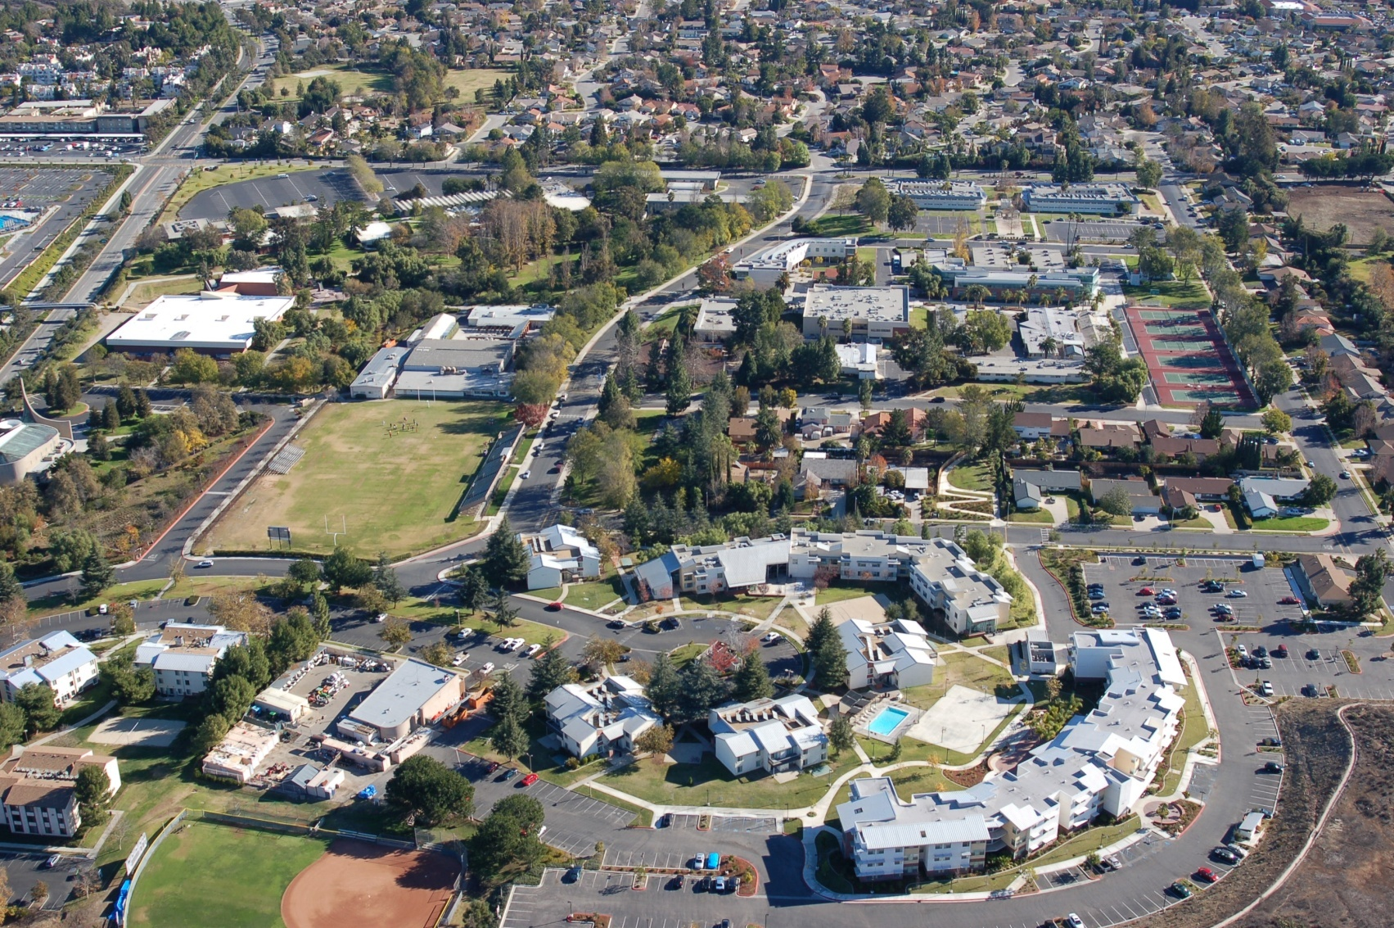
QUESTIONS

